Slide 1
Healthcare Organizations and Management
Managing the Increasing Ageing Population

Slide 2
Outline
Introduction
Current trends in the healthcare system
Statistical analysis
Lifestyle chronic diseases
Pictorial representation
Investing in nursing homes
Need for technology in nursing homes
Conclusion
References

Slide 3
Introduction
High increase in the number of the aging population in the country which has posed a great challenge in most nursing homes
Most families in the countries are in a position to take care of the old people accordingly because of the increase in their number
Rise of the public outcry over the healthcare system for the aging population
There is need for government intervention to help curb the situation
Life expectancy in the United States has been on the decline as most of the citizens succumb to manageable illnesses; nursing homes would help changing by reducing the risks of death (Crimmins, 2015)

Slide 4
Current trends
Retirement of baby boomers to adopt to new lifestyle and some of them have also become old, adding to the aging population
Most families find it very expensive to care for the old which continue to expose them to more challenges.
Expectation for more demand for long term care for the aging population in the near future
Quality care for the aged population in most of the nursing home is absent.
Life expectancy in the United States is high but this depends on the ability to remain healthy even in old age.

Slide 5
Statistical analysis
Statistically, more than 8,000 of the Americans will attain the age of 65 years and above in the next 18 years
Life expectancy at age 50 in the United States ranked 29th highest in the world in 2006 according to the World Health Organization (2009)
The ratio of the old and young are expected to be 1:5 different from the previous ratio of 1:7
This means, the number of the young population who can take care of the old will reduce

Slide 6
Lifestyle chronic diseases
According to research, old age is closely related to attack by lifestyle chronic diseases.
When attacked by this diseases, they often require frequent check ups which they may not be offered by most caretakers.
21 % of Medicaid expenditure goes to the elderly; but not all the aged population who are admitted to the nursing home get these funds
Valiyeva et al. (2006) concludes that these lifestyle diseases are also associated with a higher admission rate in nursing homes with diabetes having more than triple risk of admission.

Slide 7
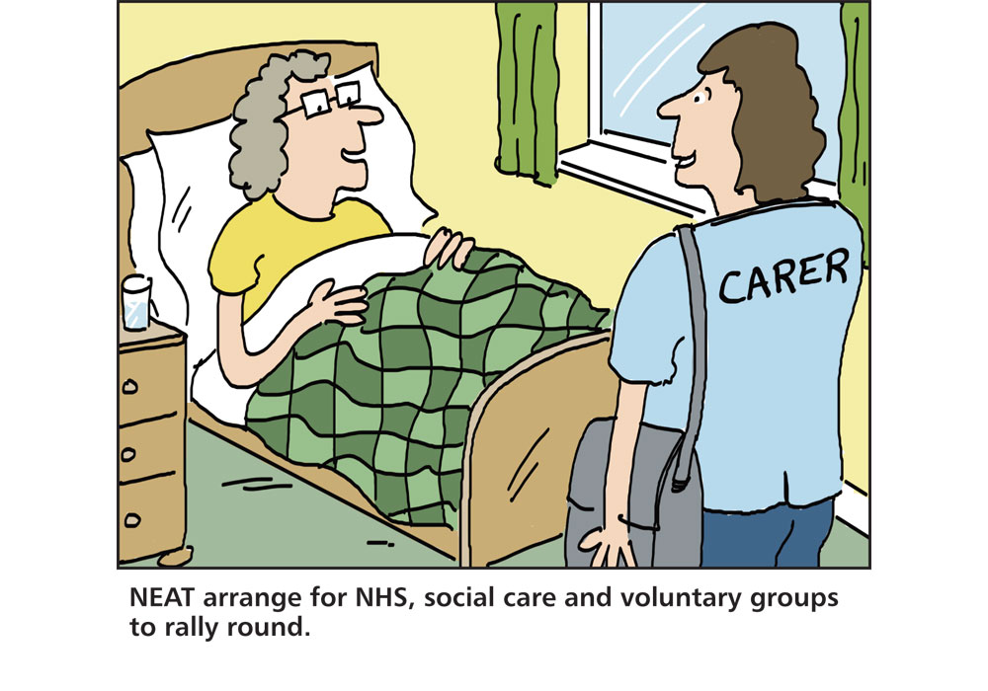
Pictorial presentation

Slide 8
Pictorial illustration
The pictorial presentation above shows an old man in a nursing home who has become disabled as a result of the frequent attack by the lifestyle chronic diseases.
Beyond, A. A. R. P., (2016). 50.2003: A Report to the Nation on Independent Living and Disability, 2003.

Slide 9
Investing in nursing homes
The government should invest heavily on the health care system especially the nursing homes to help accommodate to increased aging population
There is need for the nursing to expand their services in many parts of the country to avoid overcrowding in one home which can lead to more problems (Valiyeva et al, 2006). .
Investment in the nursing home should also be accompanied by quality control to ensure the provision of quality services

Slide 10
Need for technology
Technological innovations in the nursing home is an important idea to will help reduces case of delayed services
Use of electronic health records or electronic medical records in this home can help those who monitor the health of the aged to effectively nurse them

Slide 11
Conclusion
Conclusively, the government should fully take charge in ensuring that the nursing homes are adequate enough
the need for quality service to these patients in the nursing homes still calls for more funds
Technological implementation is a promising idea which can help monitor the services offered to the aged population in their respective homes.

Slide 12
References
Crimmins, E. M. (2015). Lifespan and healthspan: past, present, and promise. The Gerontologist, 55(6), 901-911.
Golubic, M. (2013). Lifestyle choices: root causes of chronic diseases. Cleveland Clinic online: https://my. Clevelandclinic. Org/health/transcripts/1444_lifestyle-choices-root-causes-of-chronic-diseases.
Gray, B. H. (2006). The changing structure of the nursing home industry and the impact of ownership on quality, cost, and access. In For-profit enterprise in health care. National Academies Press (US).
Pharr, J. R., Dodge Francis, C., Terry, C., & Clark, M. C. (2014). Culture, caregiving, and health: exploring the influence of culture on family caregiver experiences. ISRN Public Health, 2014.
Preston, S. H., & Ho, J. Y. (2009). Low life expectancy in the United States: Is the health care system at fault? (No. w15213). National Bureau of Economic Research.
Valiyeva, E., Russell, L. B., Miller, J. E., & Safford, M. M. (2006). Lifestyle-related risk factors and risk of future nursing home admission. Archives of Internal Medicine, 166(9), 985-990.

